Slide 1
2
Chapter
The
Management
Environment
Copyright ©2011 Pearson Education

Slide 2
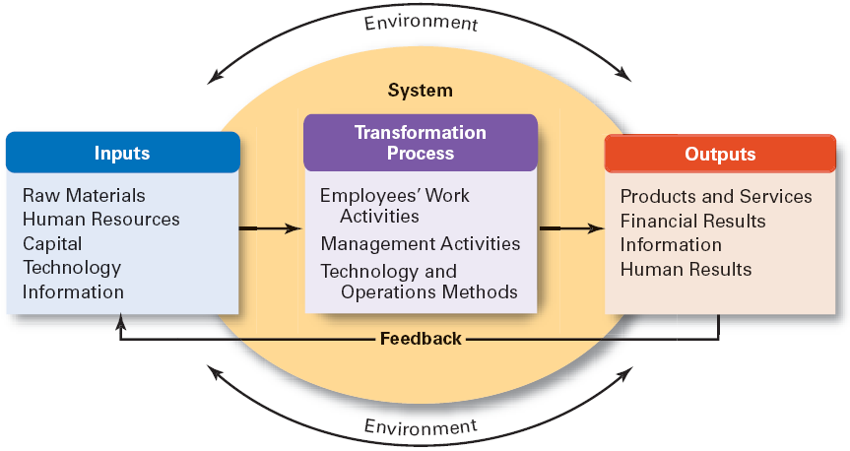
The Organization as an Open System

Slide 3
What Factors Are Reshaping and Redefining Management?
Today managers must deal with
  Changing workplaces and diversity
  Ethical and trust issues
  Global economic uncertainties
  Changing technologies
  Demanding (more than ever) customers
Managers everywhere have to manage in changing circumstances and in fact management is changing.

Slide 4
Why Are Customers Important to the Manager’s Job?
Without customers most organizations would cease to exist
Today companies discover once again that employee (internal customer) attitudes and behaviors play a big part in customer satisfaction
Managers must create a customer responsive environment, where employees are friendly, knowledgeable, responsive to customer needs
Copyright ©2011 Pearson Education

Slide 5
Can Organizations Improve
Customer Service?
Creating a Customer –Responsive Culture
  Type of employee (friendly, outgoing)
  Employees need freedom to meet changing customer-service requirements
  Employees must be empowered with decision discretion
  Employees must be good listeners
Copyright ©2011 Pearson Education

Slide 6
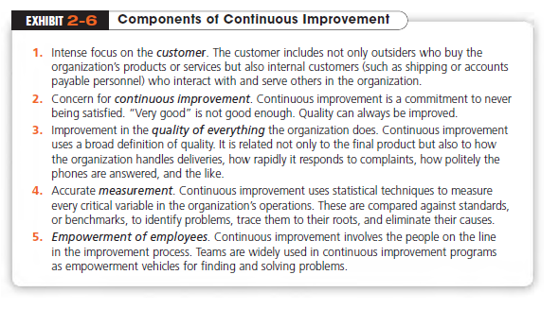
Copyright ©2011 Pearson Education

Slide 7
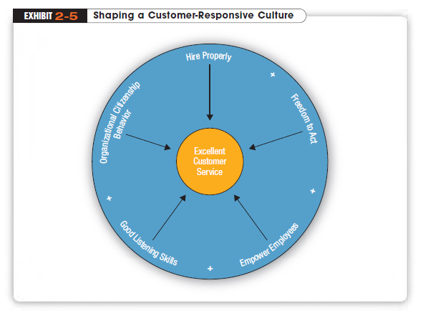
Copyright ©2011 Pearson Education

Slide 8
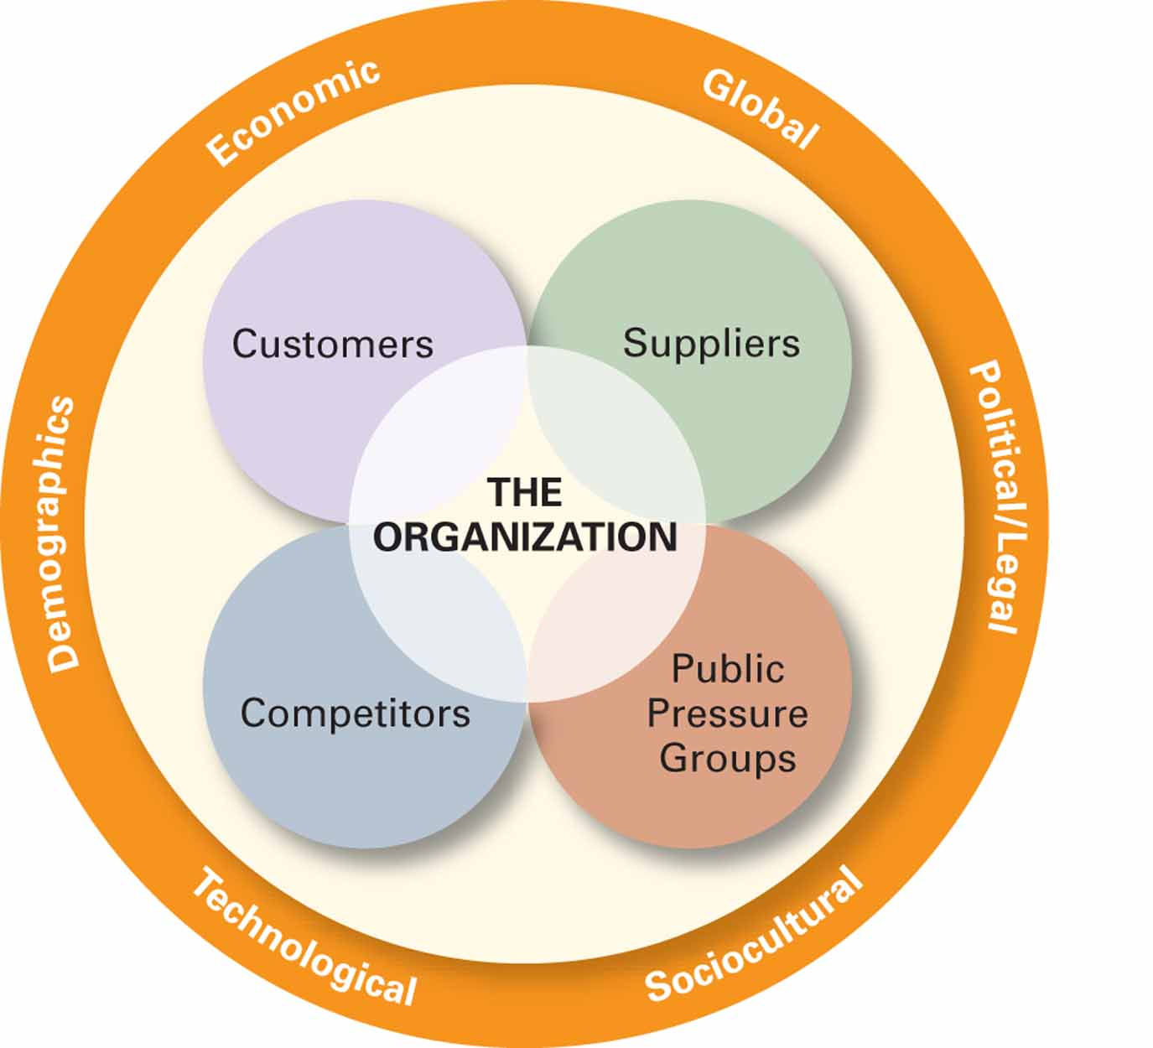
The External Environment

Slide 9
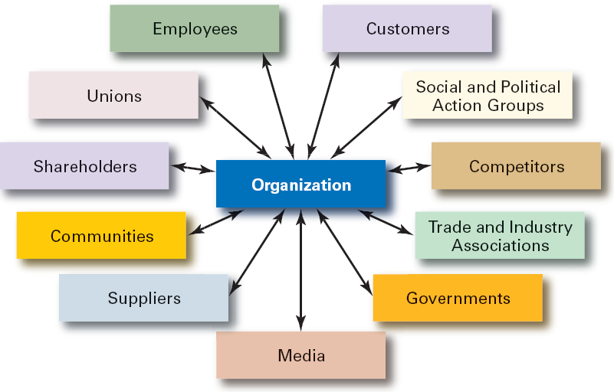
Exhibit 3 Organizational Stakeholders

Slide 10
Technology and the Manager’s Job
Continuing advances in technology make work more efficient and improve available information and communication
Technology
  Any equipment, tools, or operating methods that are designed to make work more efficient
Copyright ©2011 Pearson Education

Slide 11

The Technology Driven Workplace: Types of E-Commerce
Business-to-Consumer B2C
Selling Products and
Services Online
Consumer-to-Consumer C2C
Electronic Markets
Created by Web-Based Intermediaries
Business-to-Business B2B
Transactions Between Organizations

Slide 12
How Does Globalization Affect Organizations?(search the types of company)
Global Village
  The concept of a boundaryless world where goods and services are produced and marketed worldwide
Multinational Corporation (MNC)
  Any type of international company that maintains operations in multiple countries.
Multidomestic Corporation
  An MNC that decentralizes management and other decisions to the local country where it’s doing business.
Copyright ©2011 Pearson Education

Slide 13
Other Types of Global Organizations
Global Corporation
  An MNC that centralizes management and other decisions in the home country
Transnational (Borderless) Organization
  A structural arrangement for global organizations that eliminates artificial geographical barriers.

Slide 14
How Do Organizations Go Global?
Global Sourcing
  Purchasing materials or labor from around the world wherever it is cheapest
Exporting
  Making products domestically and selling them abroad
Importing
  Acquiring products made abroad and selling them domestically
Copyright ©2011 Pearson Education

Slide 15
Going Global (cont.)
Licensing
  An agreement primarily used by manufacturing businesses in which an organization gives another the right, for a fee, to make or sell its products, using its technology or product specifications
Franchising
  An agreement primarily used by service businesses in which an organization gives another organization the right, for a fee, to use importing its name and operating methods
Copyright ©2011 Pearson Education

Slide 16
Going Global (cont.)
Global Strategic Alliance
  A partnership between an organization and a foreign company partner(s) in which resources and knowledge are shared in developing new products or building production facilities
Joint Venture
  A specific type of strategic alliance in which the partners agree to form a separate, independent organization for some business purpose
Notes:
Once an organization has been doing business internationally for a while and has gained experience
in international markets, managers may decide to make more of a direct investment. One way to do this is
through a global strategic alliance, which is a partnership between an organization and a foreign company
partner or partners in which both share resources and knowledge in developing new products or building
production facilities.
A specific type of strategic alliance in which the partners form a separate, independent organization for some business purpose is called a joint venture.

Slide 17
Going Global (cont.)
Foreign Subsidiary
  A direct investment in a foreign country that involves setting up a separate and independent facility or office
Notes:
(centralized control).

Slide 18
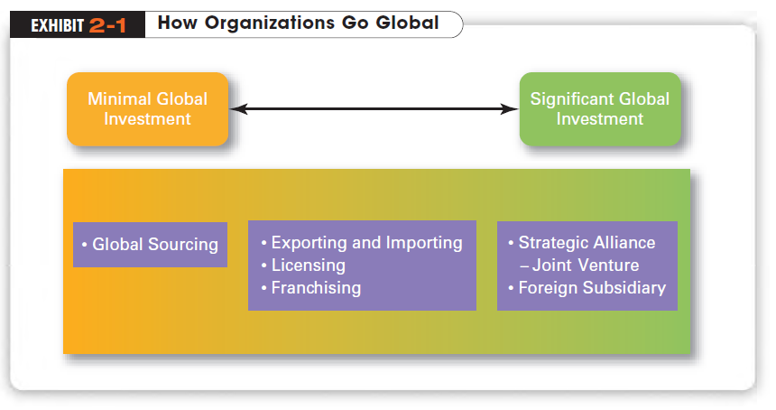
Notes:
When organizations do go global, they often use different approaches.

Slide 19
What Do Managers Need to Know?
Avoid Parochialism
  A narrow focus in which managers see things only through their own eyes and from their own perspective
All countries have different values, morals, customs, political and economic systems, and laws, all of which can affect how a business is managed
Copyright ©2011 Pearson Education
Notes:
U.S. managers once held (and some still do hold) a rather parochial view of the world of business. Parochialism is a narrow focus in which managers see things only through their own eyes and from their own perspectives. They don’t recognize that people from other countries have different ways of doing things or that they live differently from Americans.

Slide 20
Hofstede’s Framework
Geert Hofstede
  Studied differences in culture and found that managers and employees vary on five value dimensions of national culture:
  Power Distance
  Individualism vs. Collectivism
  Achievement vs. Nurturing
  Uncertainty Avoidance
  Long-term vs. Short-term Orientation
Notes:
Geert Hofstede’s framework is one of the most widely referenced approaches for analyzing cultural variations. His work has had a major impact on
what we know about cultural differences among countries

Slide 21
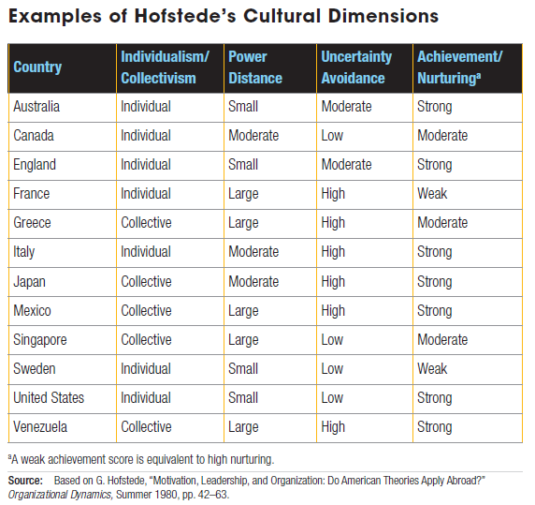
Turkey | ? | ? | ? | ?
Turkey | Collective | Large | High | Weak

Slide 22
GLOBE Findings
Global Leadership and Organizational Behavior Effectiveness (GLOBE)
  An ongoing cross-cultural investigation of leadership and national culture
  Identified nine dimensions on which national cultures differ
  Confirm that Hofstede’s dimensions are still valid, and extend his research rather than replace it
Notes:
Although Hofstede’s work has provided the basic framework for differentiating among national cultures, the data are nearly 30 years old. Another more recent research program called Global Leadership and Organizational Behavior Effectiveness (GLOBE) is an ongoing cross-cultural investigation of leadership and national culture. Using data from more than 18,000 managers in 62 countries, the GLOBE research team (led by Robert House) has identified nine dimensions on which national cultures differ

Slide 23
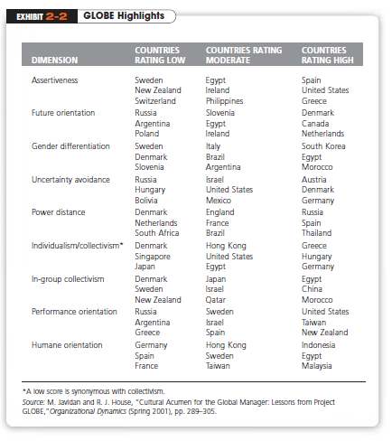
Turkey
Moderate
Low
High
High
High
Moderate
High
Moderate
High
Notes:
The GLOBE studies confirm that Hofstede’s dimensions are still valid, and extend his research rather than
replace it. GLOBE’s added dimensions provide an expanded and updated measure of countries’ cultural differences. It’s
likely that cross-cultural studies of human behavior and organizational practices will increasingly use the GLOBE
dimensions to assess differences between countries.

Slide 24
How Does Today’s Workforce Impact Management?
Workforce Diversity
  Ways in which people in a workforce are similar or different from one another in terms of
    Gender
    Age
    Race
    Sexual Orientation
    Ethnicity
    Cultural Background
    Physical Abilities and Disabilities
Notes:
An important challenge facing today’s organizations is adapting to a diverse workforce. Workforce diversity refers to ways in which people in a workforce are similar and different from one another in terms of gender, age, race, sexual orientation, ethnicity, cultural background, and physical abilities and disabilities.
Until recently, organizations took a “melting pot” approach to diversity. It was assumed that people who were different would somehow automatically want to assimilate. But today’s managers find that employees do not set aside their cultural values and lifestyle preferences when they come to work

Slide 25
How Are Managers Adapting to a Changing Workforce?
Family-Friendly Benefits
    Benefits that provide a wide range of scheduling options that allow employees more alternatives, accommodating their needs for work/life balance
Contingent Workforce
    Part-time, temporary, and contract workers who are available for hire on an as-needed basis
More flexible work arrangements
Copyright ©2011 Pearson Education

Slide 26
Generational Values
Cohort | Entered Workforce | Approximate Date of Birth | Dominant Work Values
Veterans | 1950-1964 | born before 1946 | Hard working, conservative, conforming; loyalty to the organization
Boomers | 1965-1985 | 1946 and 1961 | Success, achievement, ambition, dislike of authority; loyalty to career
Xers | 1985-2000 | 1962-1981 | Work/life balance, team-oriented, dislike of rules; loyalty to relationships
Millennials or Ys | 2000-Present | 1982- | Confident, self-reliant but a team-member, financial success oriented; loyalty to both self and relationships

Slide 27
Inelmen et al. (2012) “Managing the New Workforce”
Independent Variables | Millennials (Ys) n₁=83 | Generation Xers n₂=76
Education | -.060 | .113
Tenure | -.004 | -.233*
Affective Commitment | .574*** | .064
Normative Commitment | .118 | .563***
Financial Satisfaction | .342** | .060
Work Satisfaction | .001 | .245
F | 21.297*** | 17.350***
Adjusted R² | .701 | .716

Slide 28
Growing literature suggests Millennial employees
  have higher expectations: look for quick advancement opportunities; flexible work hours; work-life balance; travelling opportunities; and high income
  highly involved with digital technology; are more inclined to change jobs; constantly in search for a better job → career focused life is outdated
  because this group has lot to offer organizations in terms of knowledge, passion and abilities, managers have to find ways the work can be done effectively and efficiently without disruptive conflict.

Slide 29
Overview
Not everyone is motivated to perform managerial functions.
Note, that this instrument emphasizes tasks associated with managing in larger and more bureaucratic organizations. A low or moderate score may indicate that you’re more suited to managing in a small firm, in a more flexible unstructured organization, or in entrepreneurial situations.
This instrument is interesting in light of the evolution of even larger organizations to working as teams or in a virtual reality. Because of the changing nature of organizations from «learning organizations» to «flat structures», the approach to management is altered to one of coaching rather than directing.
Whether one is drawn to being a manager will depend largely on the structure of the organization.

Slide 30
The Paradox of Diversity
When organizations bring in diverse individuals and socialize them into the culture, a paradox is created.
  Managers want the new employees to accept the organization’s core cultural values and openly acknowledge, embrace,
  and support the diverse perspectives and ideas that the new employees bring to the workplace.
Strong organizational cultures pressure employees to conform. A manager’s challenge is to balance two conflicting goals:
1. to encourage employees to accept the organization’s dominant values
2. to encourage employees to accept differences.

Slide 31
Organization Culture Issues
Creating an Ethical Culture
  Focus on process, as well as outcomes
  Trust and openness
  Code of Ethics
    formal document that states an organization’s primary values and rules it expects managers and non-managerial employees to follow
  Social responsiveness
Creating an Innovative Culture
  Risk-taking
  Challenge and involvement
  Freedom
  Idea time
  Playfulness/humor
  Debates
  Conflict resolution

Slide 32

Why Is Innovation Important to the Manager’s Job?
“Nothing is more risky than not innovating”
Innovation is not just important for high technology companies, but nowadays essential in all types of organizations.
Managers everywhere have to manage in changing circumstances, and in fact management is changing.

Slide 33

What Does Society Expect from
Organizations and Managers?
Green Management
  When managers recognize and consider the impact of their organization and its practices on the natural environment
  The idea of being environmentally friendly or green affects many aspects of business

Slide 34
How Can Organizations Demonstrate Socially Responsible Actions?
Social Responsibility
  When a business firm engages in social actions in response to some popular social need
  A business firm’s intention, beyond its legal and economic obligations, to do the right things and act in ways that are good for society
Social Obligation
  When a business firm engages in social actions because of its obligation to meet certain economic and legal responsibilities

